Slide 1


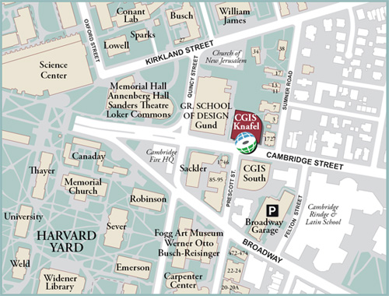
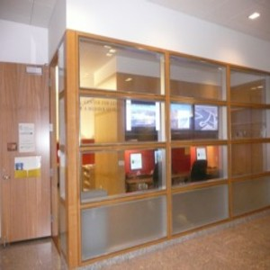

Center for Geographic Analysis services and projects
Jeff Blossom – jblossom@cga.harvard.edu
Winter GIS Institute - 2021
1737 Cambridge St. CGIS Knafel building Concourse level

Slide 2


Center for Geographic Analysis (CGA)
Founded in 2006
A member organization of the Institute for Quantitative Social Science (IQSS)
Serves the entire University – anyone with a HUID / HarvardKey

Slide 3
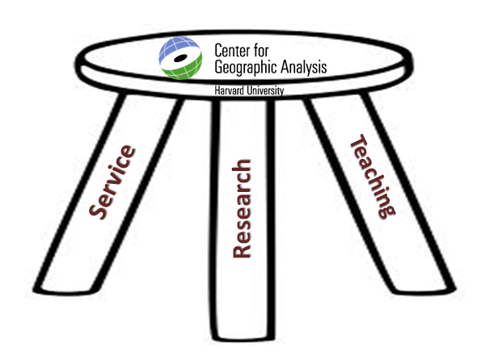
Our mission
Cultivate spatial thinking in education
Apply emerging geospatial technologies in support of research
Advance geographic information science through innovation

Slide 4

CGA People
4 full-time staff positions
5 full-time or part-time research/teaching appointments
Over a dozen visiting/affiliated appointments at any given time
Hosted over 100 visiting researchers, fellows, student interns and other affiliates since 2006.

Slide 5
CGA Basic Services
Consult for research and learning projects
Contribute to proposal development
Manage geospatial software site licenses
Host mapping services
Provide GPS and plotting equipment

Slide 6

Instructional Programs
Credit courses through FAS Government Department
Instructor-led workshops
  Basic Introduction to GIS (2 hours, each semester)
  GIS for Humanities and Social Sciences (1 day, fall semester)
  Cartography (1 day, spring semester)
  GIS Institute (2-weeks, winter and summer)
Customized course modules
Self-learning tutorials
Notes:
6

Slide 7










GIS Site Licenses

Slide 8












Web GIS & Hosted Mapping
Fusion Tables
Notes:
Today we are facing an exciting time for what concern mapping on the WEB.
There are several online platforms and tools to create a web map and visualize your data.
Many of those are free.
All of them try to minimize the barrier between non specialized users and final product (map) that gets created.
Some of them have also started to leverage the analytical side of mapping.
CGA has develop is own platform called WorldMap,
Focus on a specific Google product (Fusion Tables).
Fusion Tables is an experimental data visualization web application to gather, visualize, and share larger data tables.
So, what’s very interesting about FT from a mapping prospective is the fact that contains several geographical features
or functionality.
HyperCities: Platform for organizing historical maps collaboratively
8

Slide 9

Research Consultation
Data issues, e.g.
  Public and commercial data sources
  Data collection and management techniques
  Data conversion, scanning, digitizing, etc.
Hardware/software issues, e.g.
  What GPS to buy – accuracy, compatibility, etc.
  Which software to use for various tasks
Methodology issues, e.g.
  How to select parameters in spatial interpolation
  How to build location-allocation models
Visualization issues, e.g.
  How to do 3-D maps or time-series animation
  How to allow users make interactive maps from a web browser

Slide 10
Consultation and Service Projects usually fall into one of these 4 groups:
Geocoding
GIS Analysis
Maps and Visualization
Web Maps

Slide 11
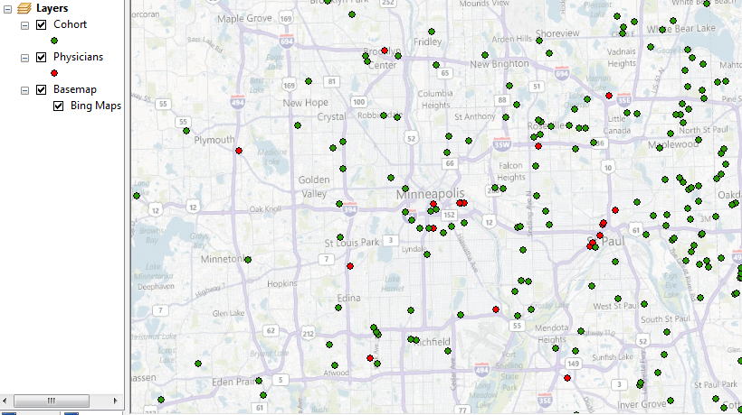
CGA Service Projects: Health Care Accessibility
How far is the nearest physician from each patient?
What are the social and environmental conditions in each patient’s neighborhood?

Slide 12
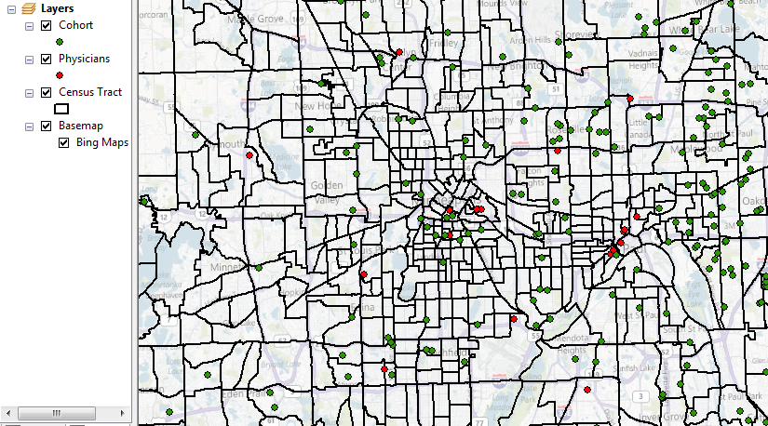
CGA Service Projects: Health Care Accessibility
Geocoding → Census tract determination

Slide 13
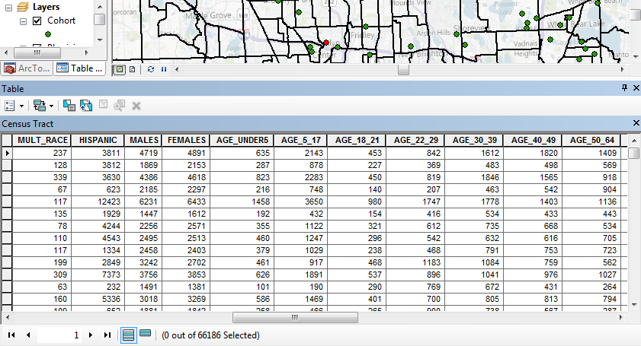
CGA Service Projects: Health Care Accessibility
Geocoding→ Census tract determination → Merge in socio-economic data from the census.

Slide 14
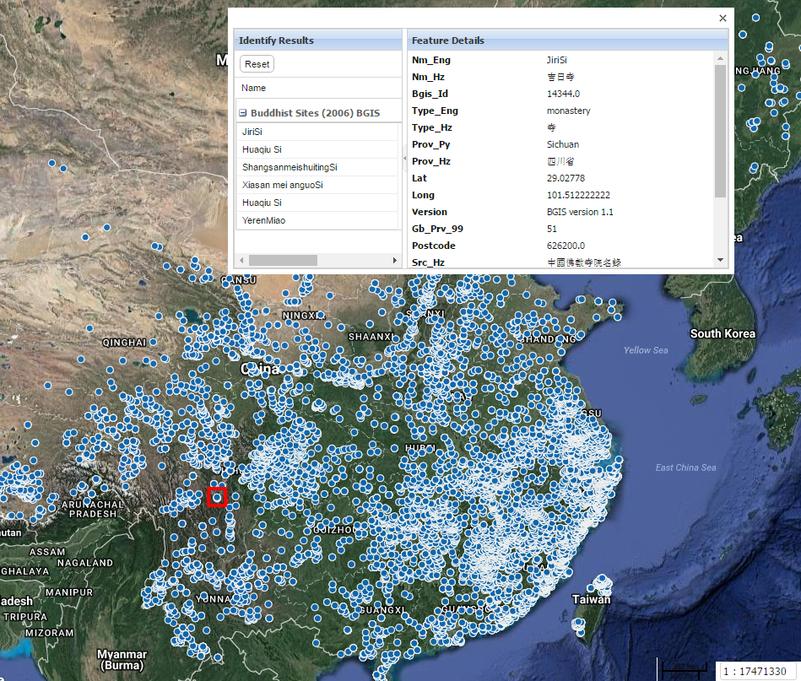
CGA Service Projects: China Historic GIS
Geocoding Buddhist monasteries
Notes:
http://worldmap.harvard.edu/maps/chinamap/WW5

Slide 15
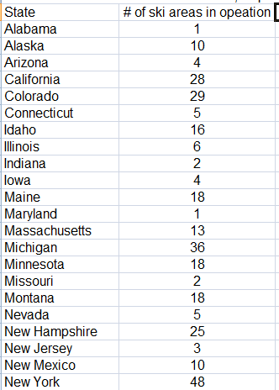
CGA Service Projects: Economic effects of U.S. ski industry
Geocoding to administrative areas to produce a thematic map such as
ski areas per U.S. state.

Slide 16
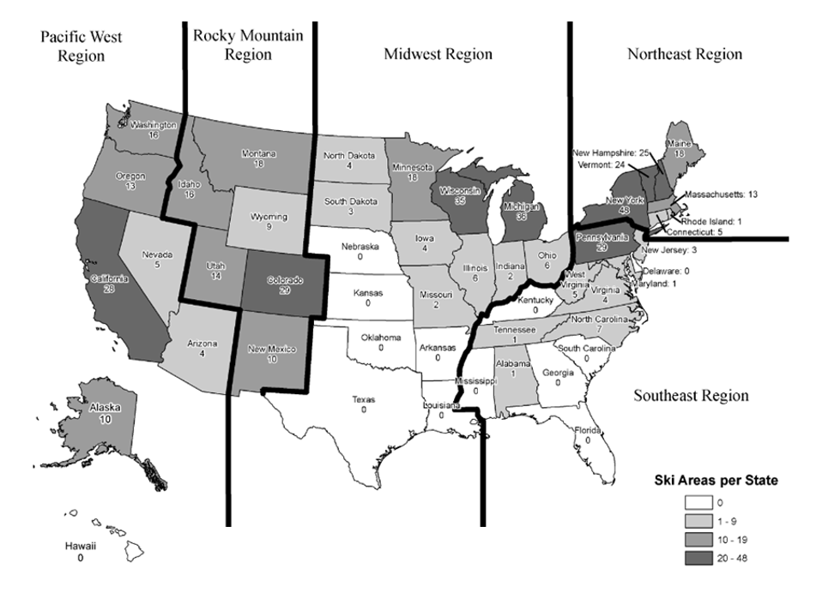
Notes:
CGA project for harvard business school

Slide 17
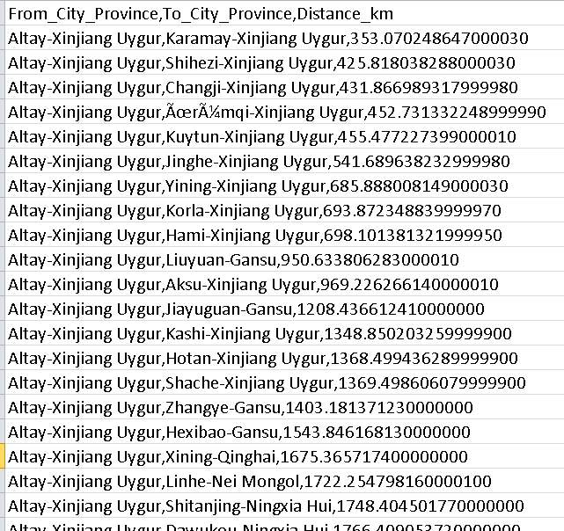
CGA Service Projects: Analysis of factory worker rights in Chinese cities.
Calculating distances between cities

Slide 18
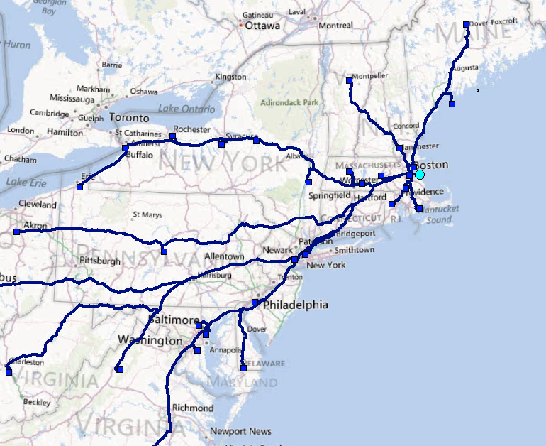
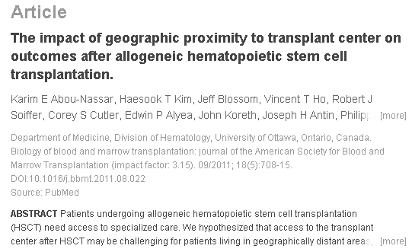

Slide 19
DATA: Specific GIS variables collected for a U.S. Asthma Study
Air Quality Distance to major road mileage of major roads nearby pollen severity, AQI, Ozone, SO2, CO, NO2, PM_2.5 distance to nearest factory, factories nearby | Community Amenity Access Distance to and densities of: Pharmacies, hospitals, subway stations, bike paths, libraries, supermarkets, athletic centers, day care centers. Extracted by NAICS codes.
Crime Homicides, rapes, robberies, assaults, thefts, auto thefts. | Consumer Spending Prescription drugs for asthma, Vitamin D supplements, total medical expenditures, groceries, fitness, pet products, vet visits.
Demographic Educational attainment, race, age, rural/urban, household size, tenure, multiple family and single parent households. | Economic Unemployment, poverty, income inequality, median household income, community economic growth or decline, food stamps, delayed rent or mortgage payments.
Housing conditions Peeling paint, water leaks, inadequate heating, # units occupied, age of structure, square footage, construction type, presence / lack of heating, air conditioning, gas stoves and heaters. | Weather/Environment Temperature, precipitation, humidity, wind speed, % sunshine, PBL, extreme weather events, NDVI.

Slide 20
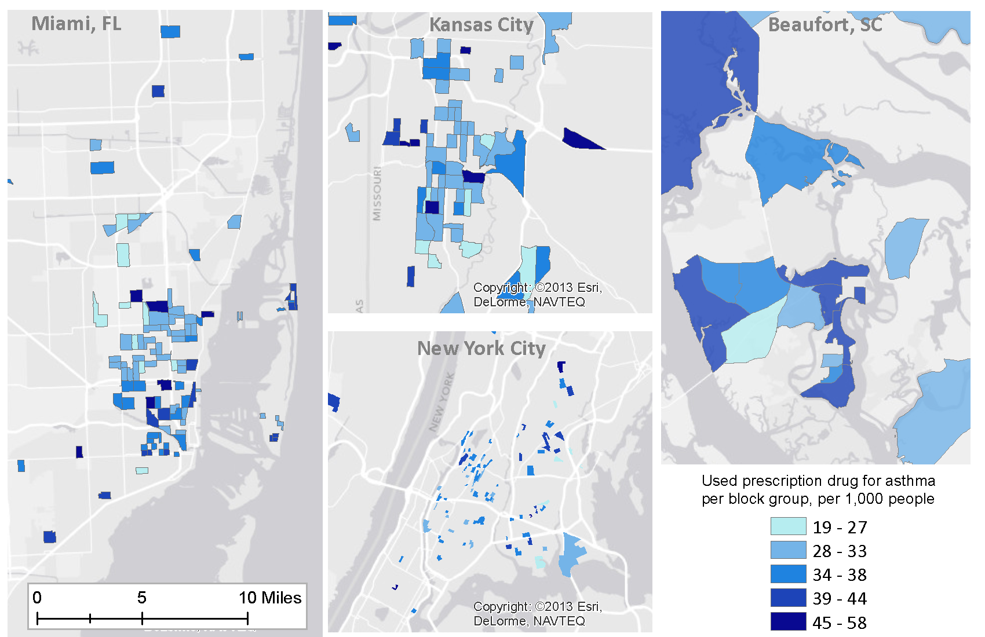
GIS Variable: Used prescription drug for asthma in 2013

Slide 21
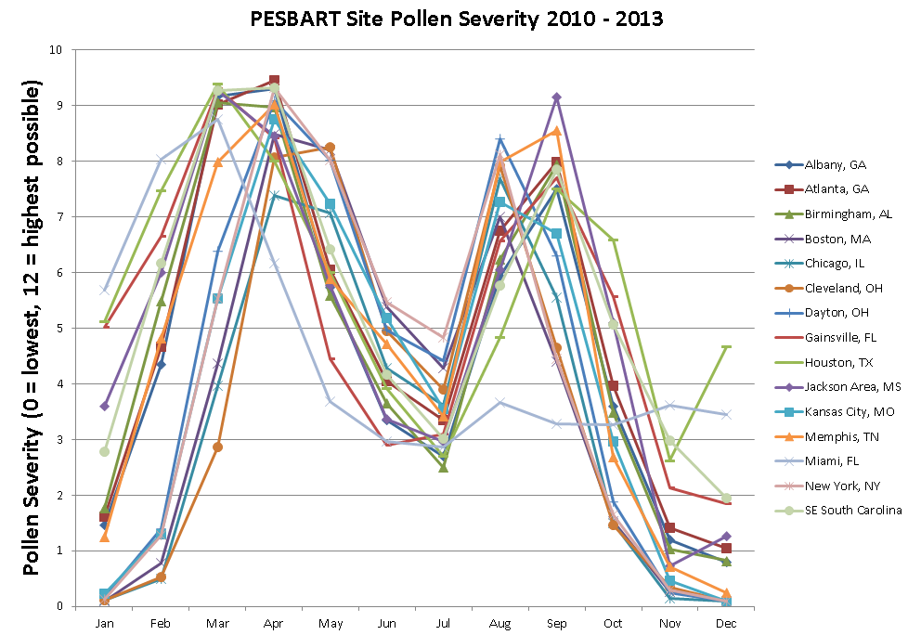

Slide 22
Global data
Global data for…..
Population Elevation
Major highways Rivers
Administrative boundaries Soil type
City/village locations Geology
Temperature Precipitation
Ecoregions Land cover
Railroads Lakes
Satellite imagery
    ……at various scales is publicly available from various sources.
    More detailed data may exist for public use from national federal, state, or local governments, OpenStreetMap, or for purchase from mapping companies.
Notes:
22

Slide 23
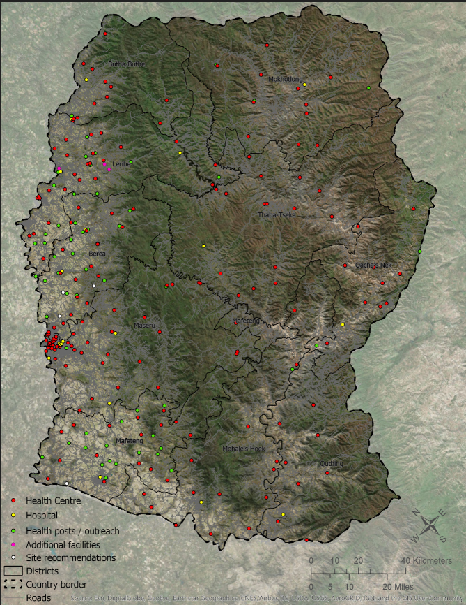
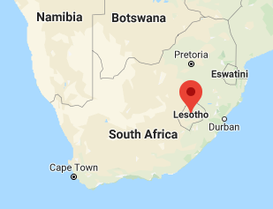
GIS Analysis
What percent of Lesotho’s total population has access to a health facility?
Input data (all publicly available sources)
Elevation – For slope creation to estimate walking speed.
Trails, roads, rivers, bridges - OpenStreetMap.
Land Cover – European Space Agency
Population – WorlPop (U. of Southampton, U.K.)
Health Centers – Ministry of Health, Lesotho

Slide 24
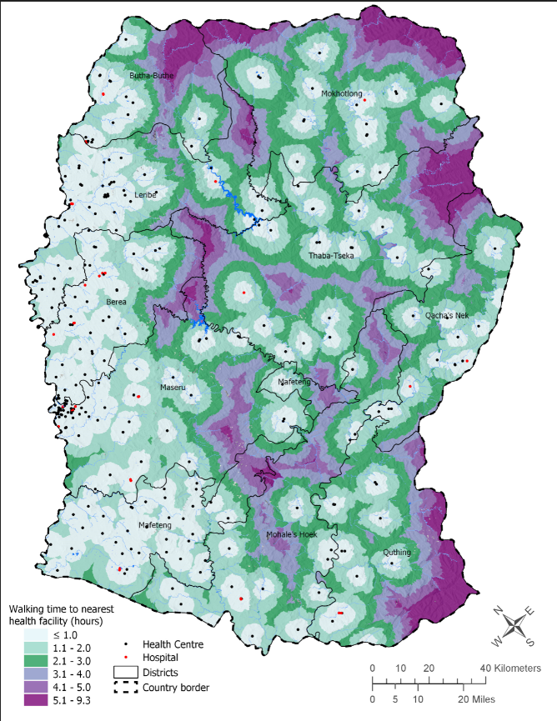
GIS Analysis
What percent of total population has access to a health facility?
Access is defined as within a 1 hour walk to a health facility in urban areas; within a 3 hour walk in rural areas.
78% of the population has access

Slide 25
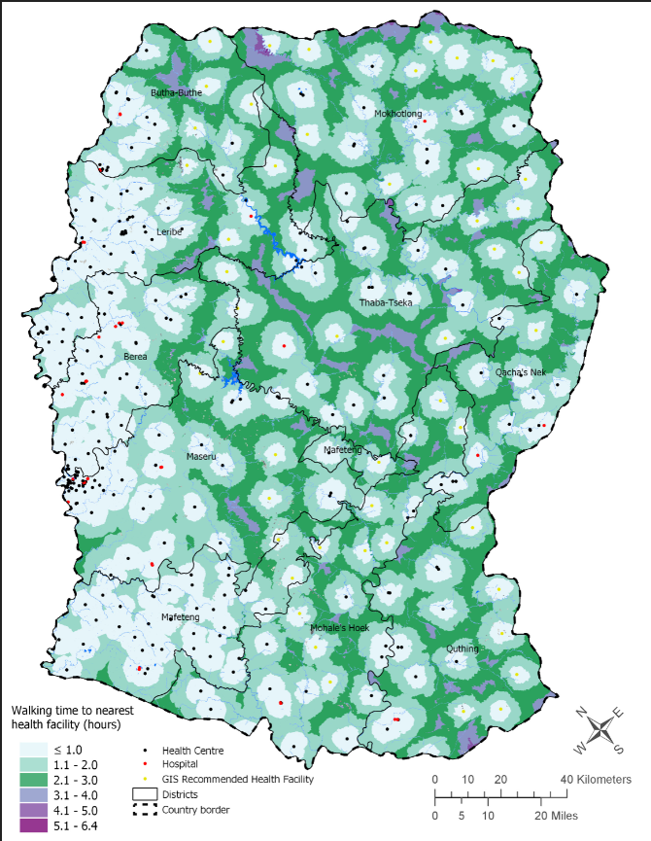
GIS Analysis
What percent of total population has access to a health facility?
Access is defined as within a 1 hour walk to a health facility in urban areas; within a 3 hour walk in rural areas.
By adding 50 new health facility locations based on the GIS analysis to the model, 90% of the population has access.

Slide 26
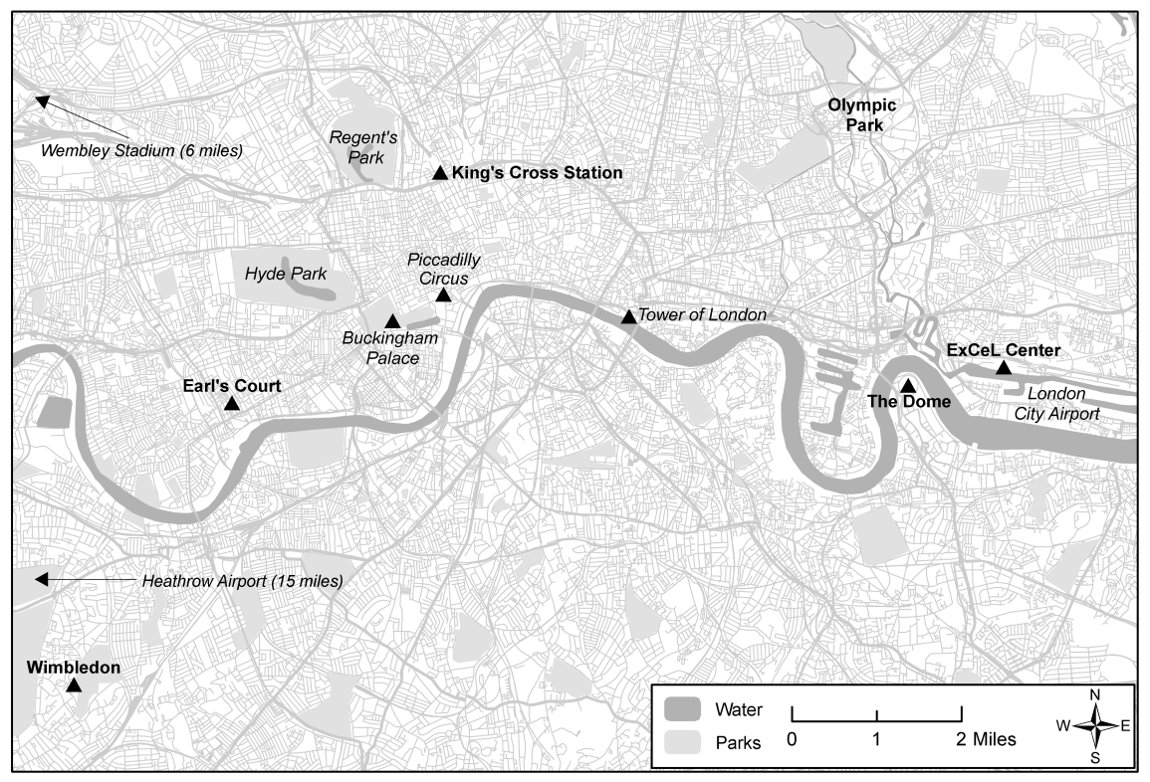
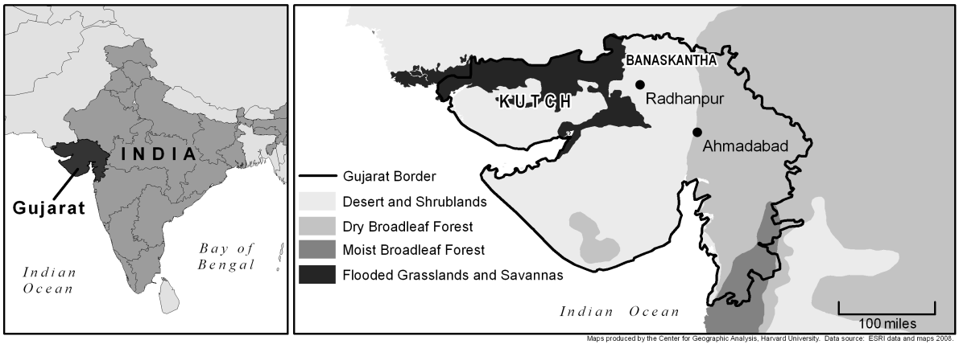
CGA Service Projects: Maps and Visualization
Venues of the 2012 London Olympics
Land cover of Gujarat province, India

Slide 27
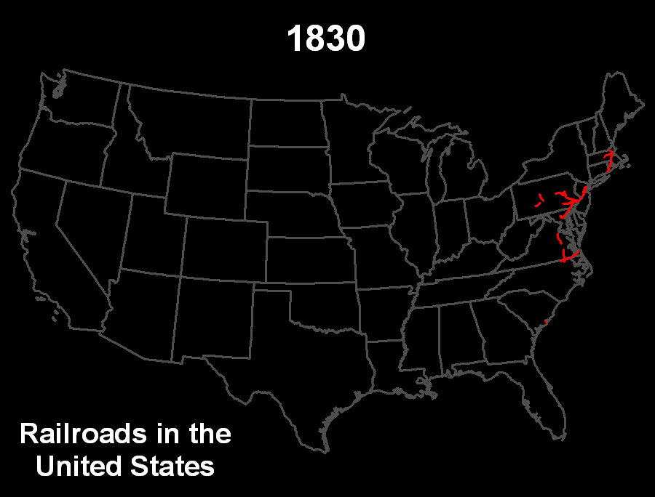
Notes:
Maps can show patterns over time.
http://www.schofieldbros.com/railroads.html

Slide 28
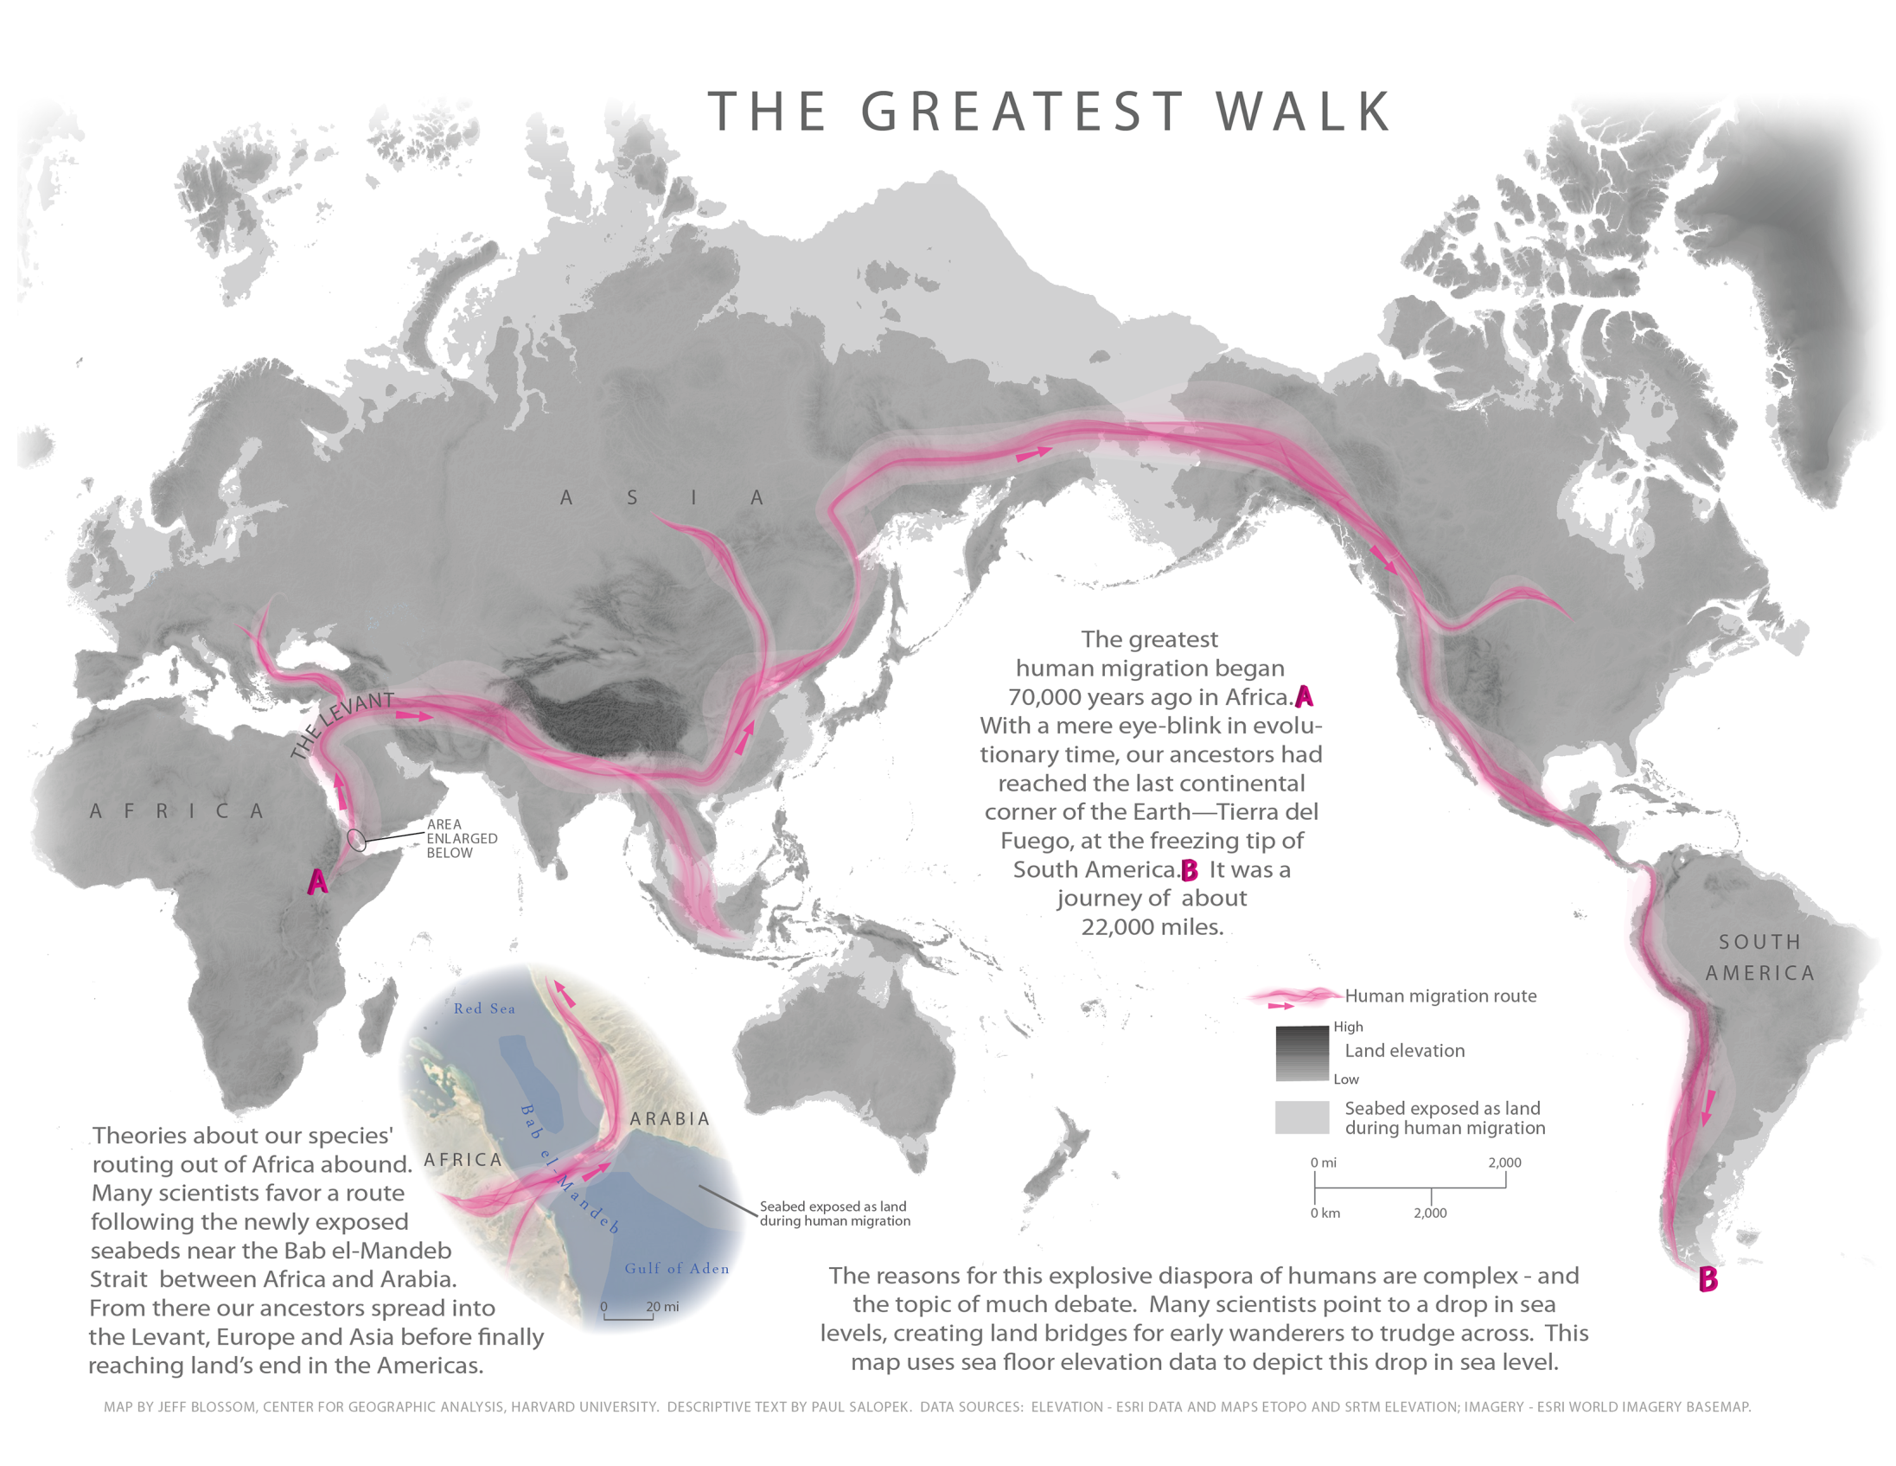


Notes:
http://www.outofedenwalk.com/
http://www.outofedenwalk.com/map-room/thematic-maps/

Slide 29
Notes:
http://www.outofedenwalk.com/
http://www.outofedenwalk.com/map-room/thematic-maps/

Slide 30
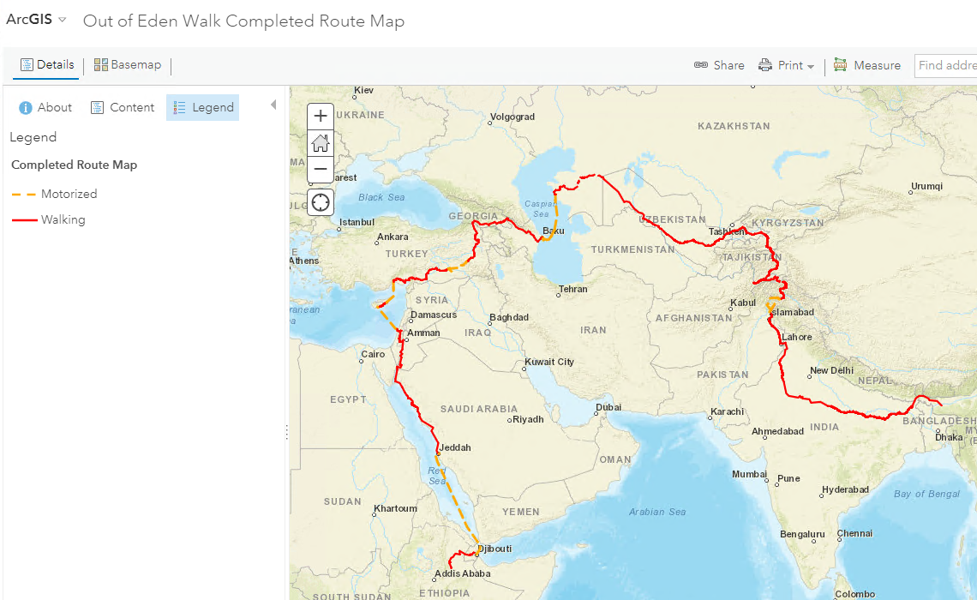
Visualizing Paul’s GPS data on a web map
http://arcg.is/0TWaae

Slide 31
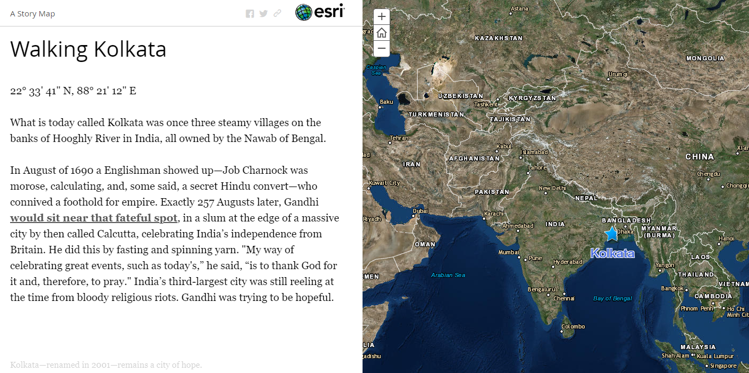
Geographic storytelling with a Story Map
https://arcg.is/1uCujX

Slide 32
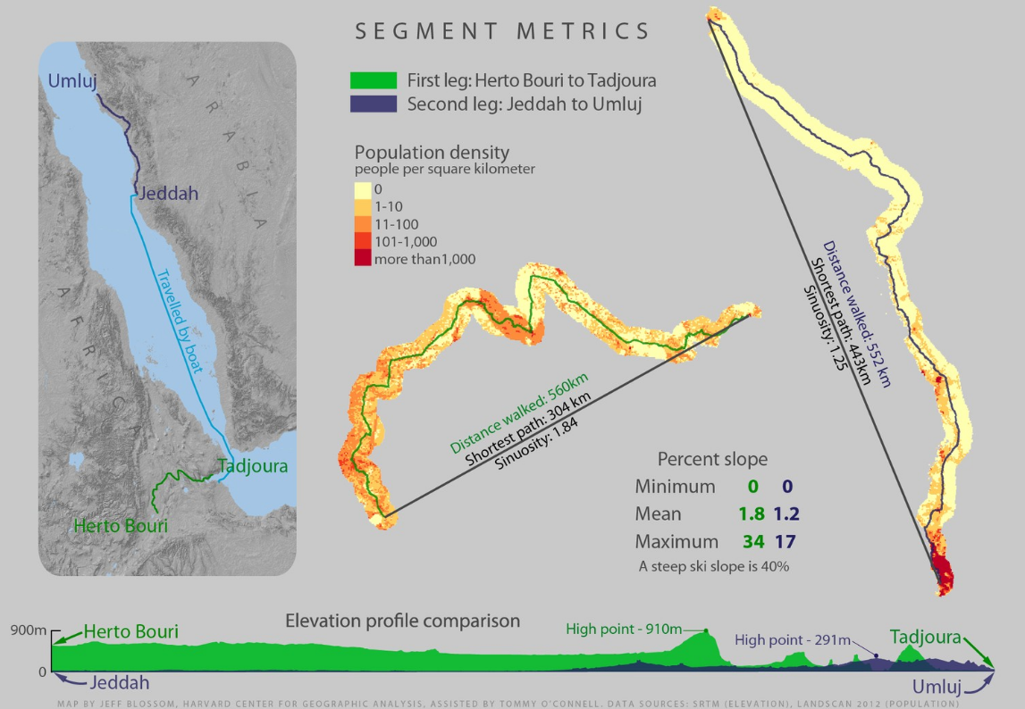
Notes:
http://www.nationalgeographic.org/projects/out-of-eden-walk/media/2013-12-1312_segment_metrics

Slide 33
CGA’s Platform Development Projects
WorldMap – open source general purpose mapping platform
HHypermap – data search platform
MapD – open source spatial GPU database (re-branded as OmniSci)
Geo-tweet Archive – harvesting geo-tweets
Billion Object Platform - making big data more accessible to scholars

Slide 34
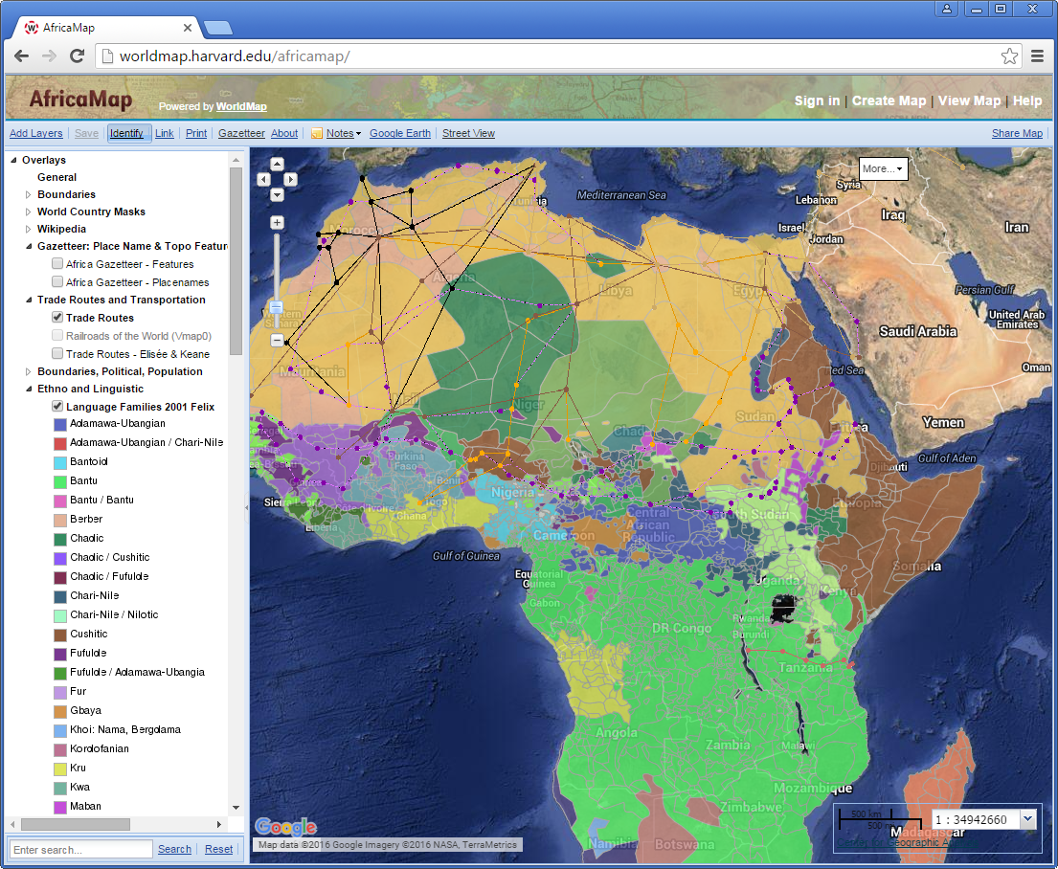
Notes:
http://worldmap.harvard.edu/africamap/

Slide 35
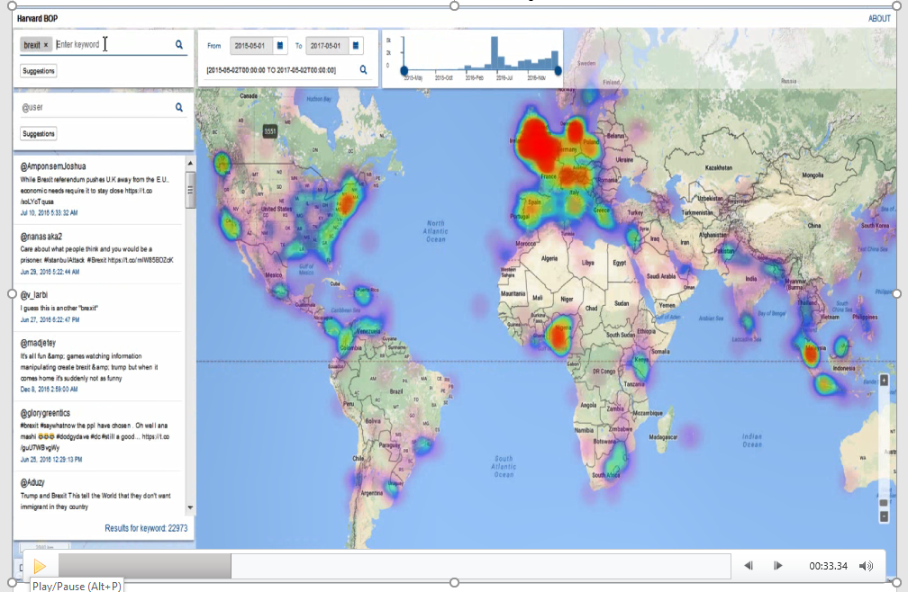
Geo-tweets with “Brexit” in them, May of 2015 – May of 2017
Notes:
Link to web map no longer exists. Contact Ben Lewis blewis@cga.Harvard.edu for the latest on the Billion Object Platform.

Slide 36
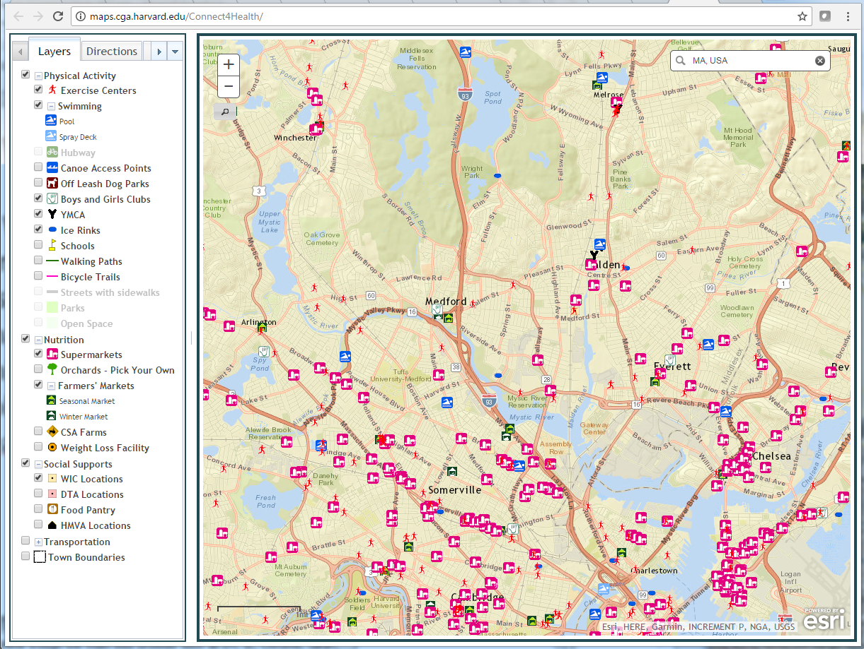
Connect4Health: Healthy eating and exercise awareness
Notes:
http://maps.cga.harvard.edu/Connect4Health/

Slide 37
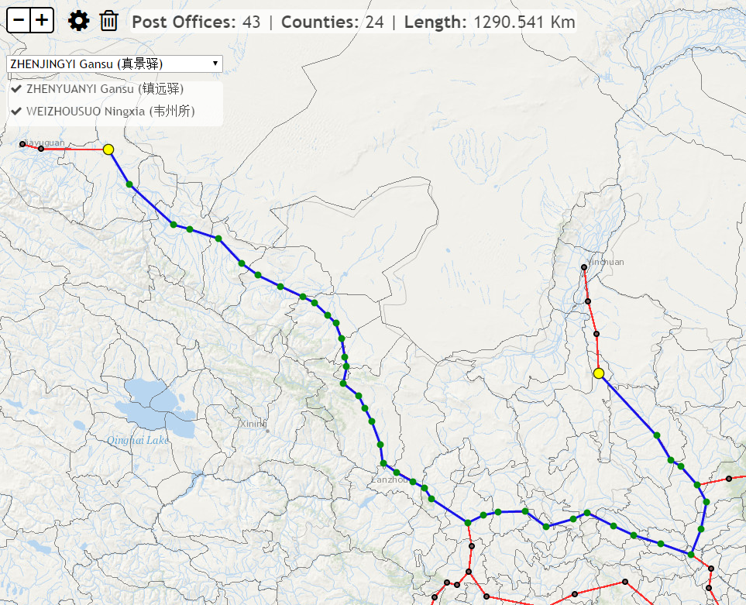
Historic analysis:
The Chinese Late Ming Dynasty Courier Route System
Notes:
http://maps.cga.harvard.edu/chinapostoffice/

Slide 38
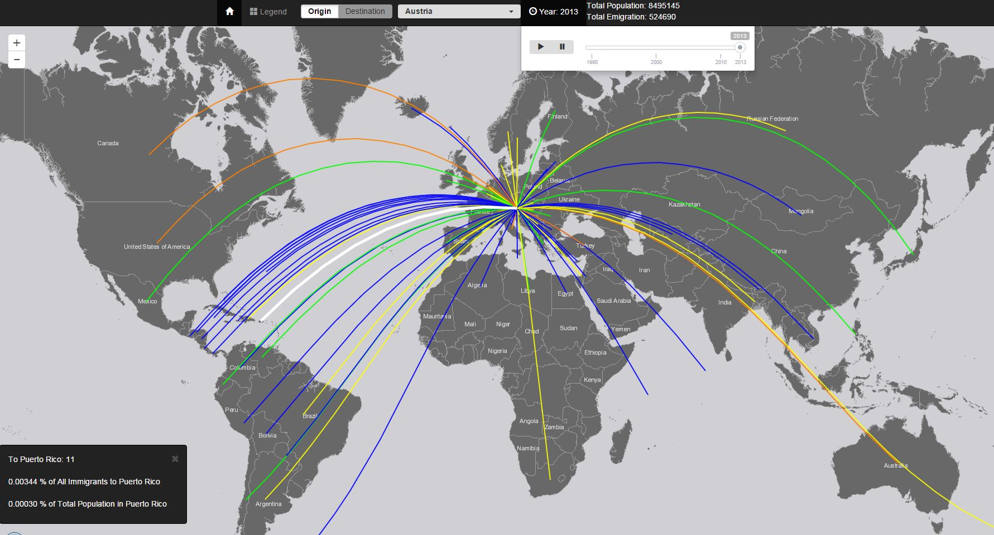
Custom web map: Esri
Visualizing global statistics: Migration
Notes:
http://crossroadsofmigration.com/

Slide 39
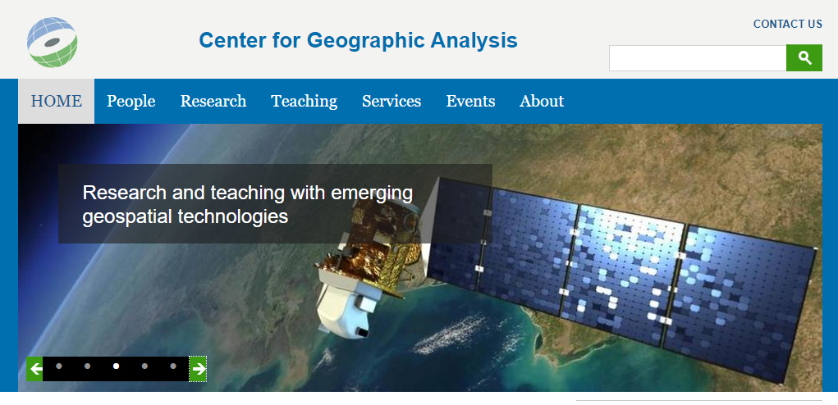
Thanks!
Jeff Blossom
jblossom@cga.harvard.edu
See more CGA projects: https://gis.harvard.edu/research-portfolio
CGA website: http://gis.harvard.edu/
CGA staff email addresses: https://gis.harvard.edu/teams
CGA general contact: http://gis.harvard.edu/contactus
Notes:
39

