Slide 1

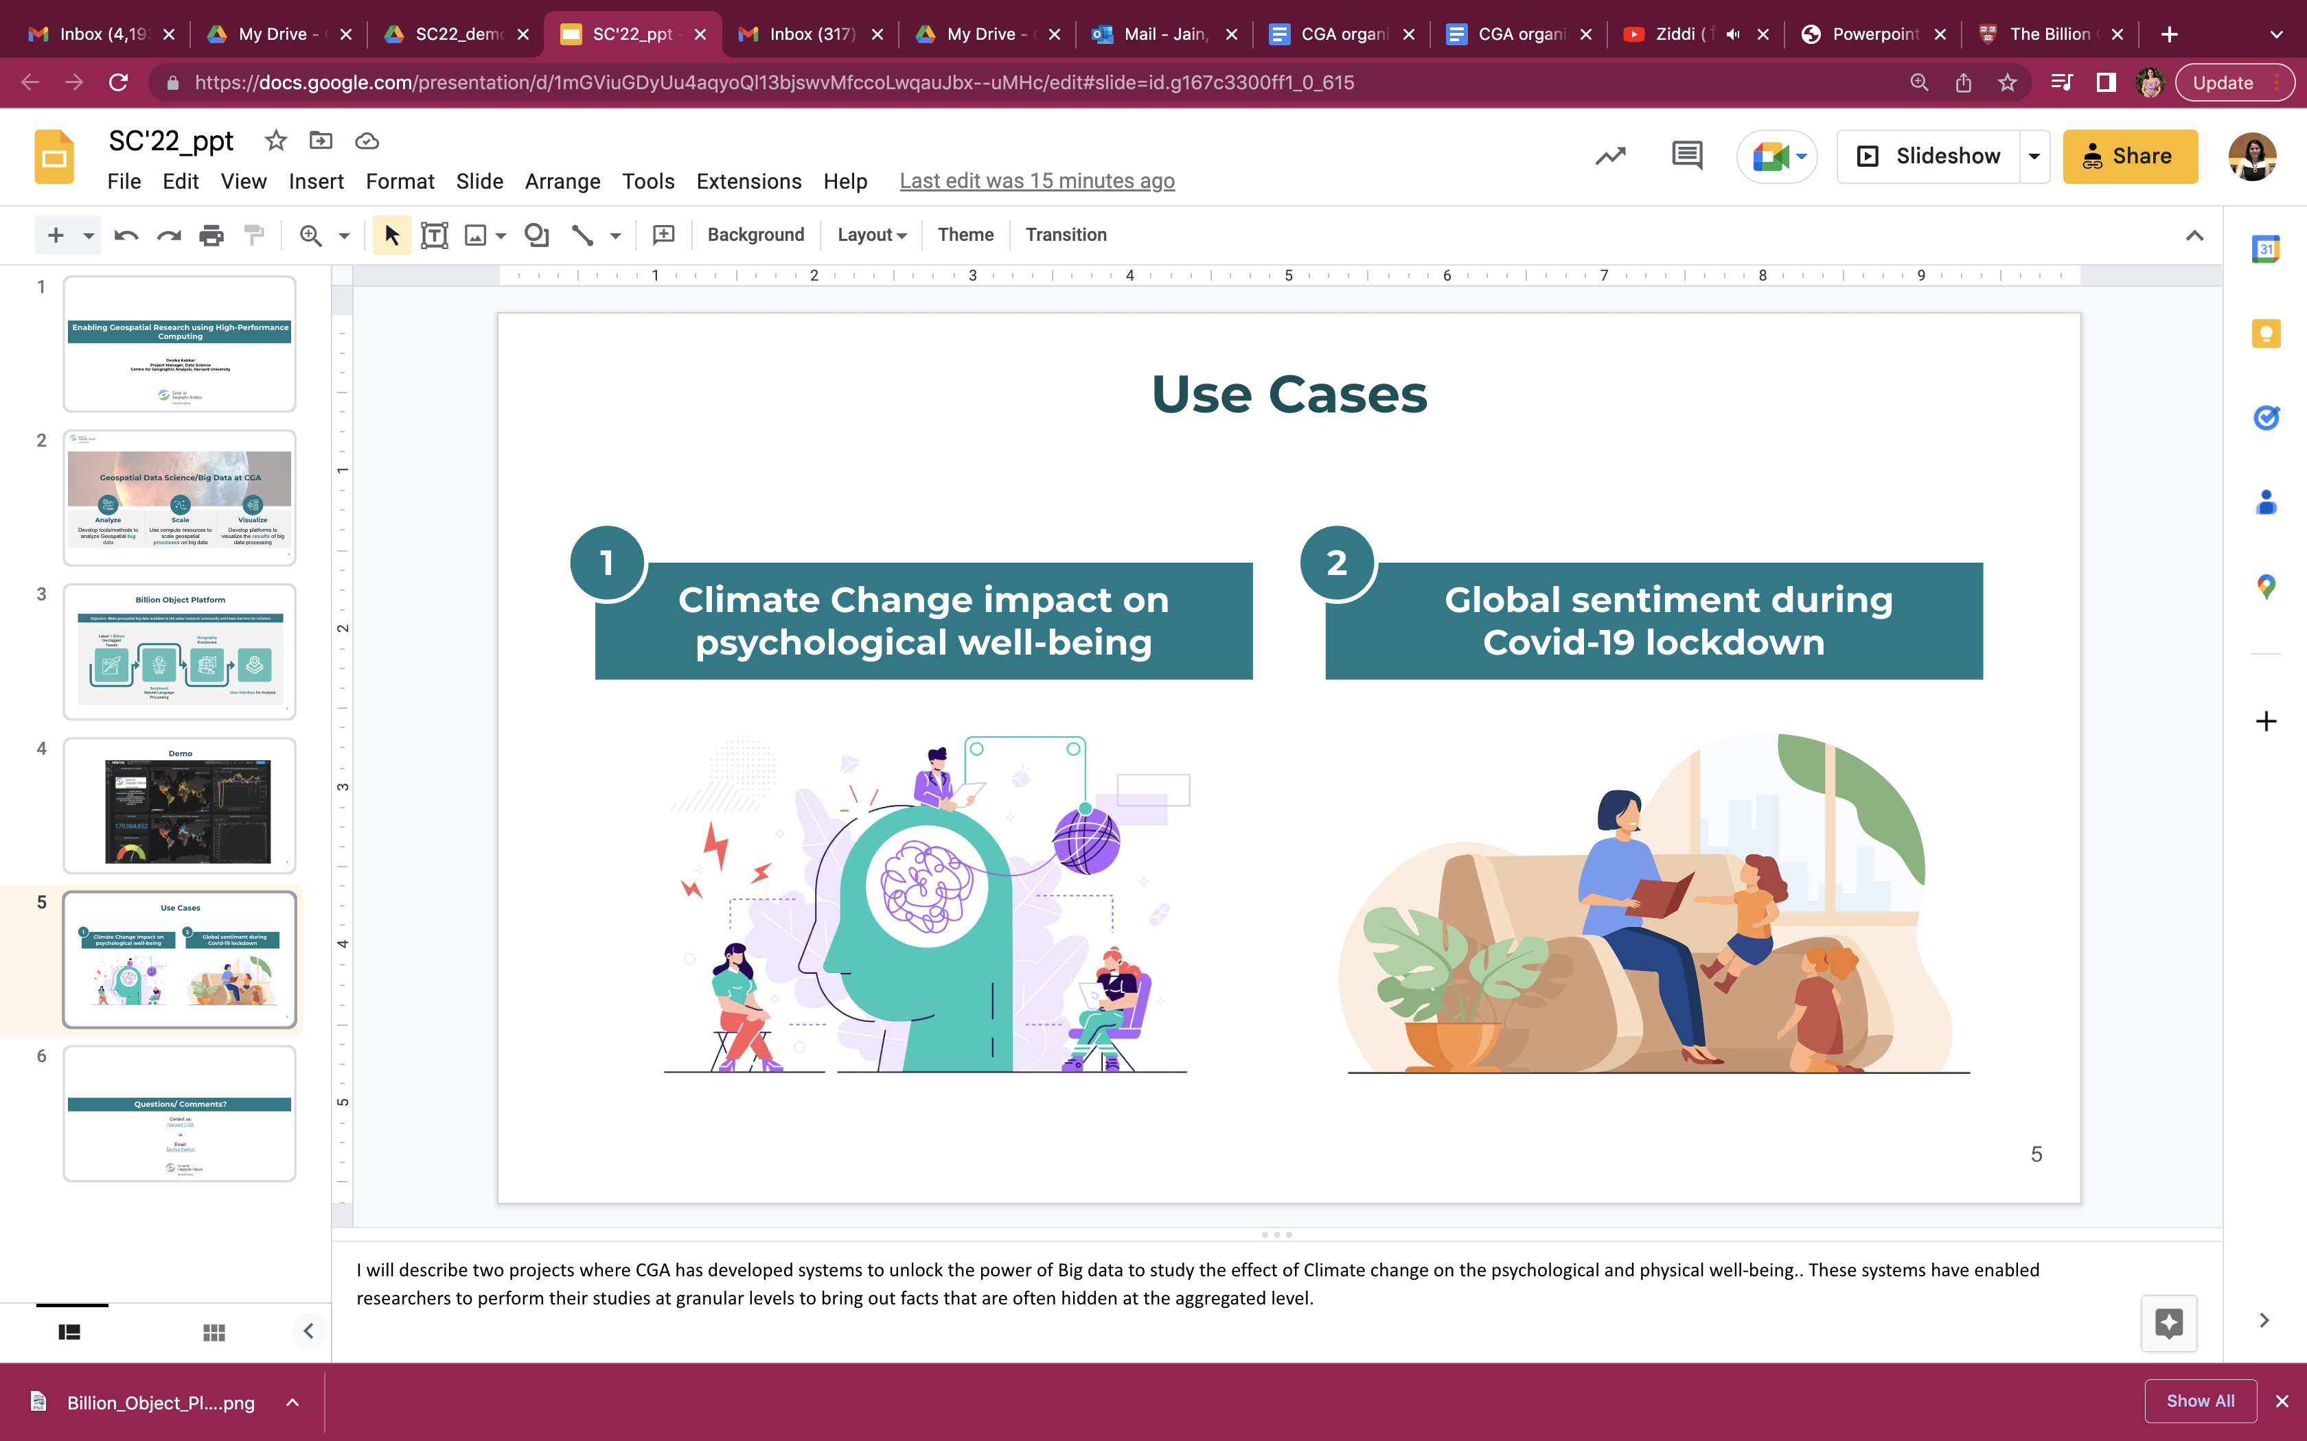
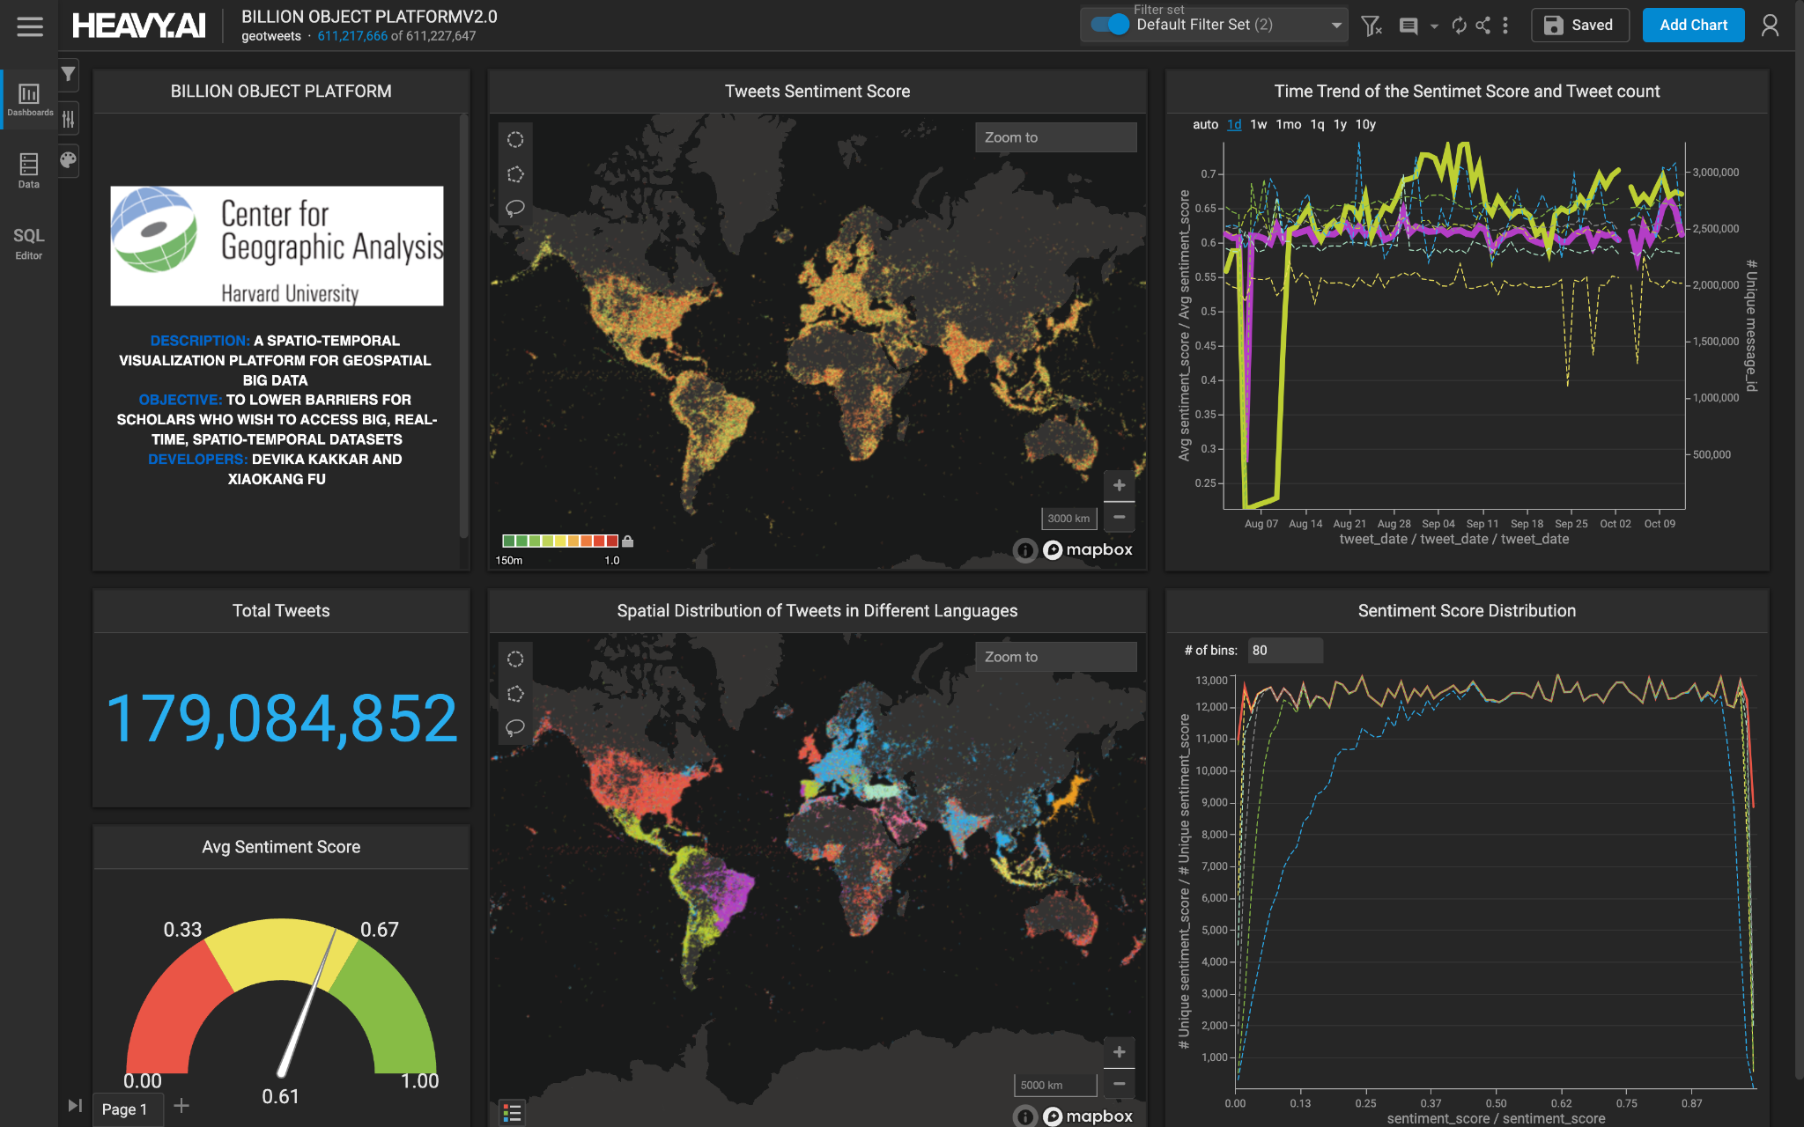

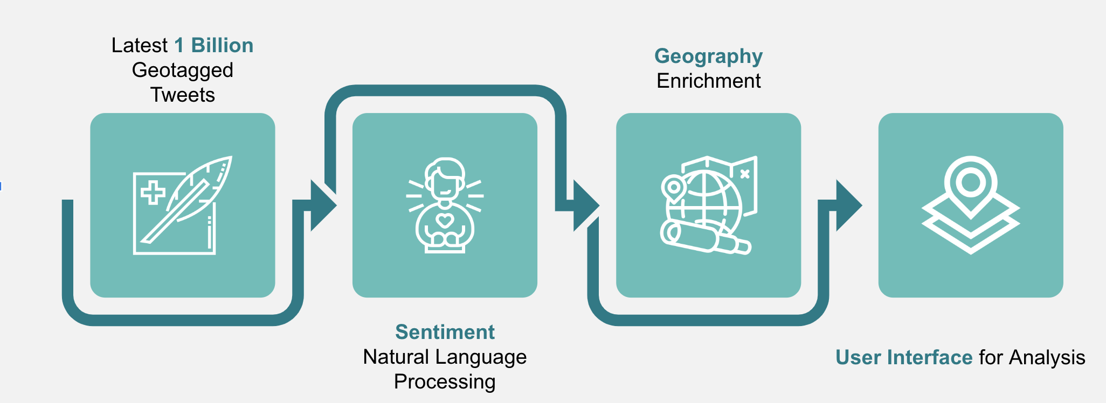
Enabling Geospatial Research using High-Performance Computing
Devika Kakkar
Project Manager, Centre for Geographic Analysis, Harvard University
Introduction
Billion Object Platform
Use Cases
Harvard Center for Geographic Analysis (CGA) has developed a prototype spatio-temporal visualization platform dubbed "the BOP" (Billion Object Platform). The main goal is to lower barriers for scholars who wish to access large, streaming, spatio-temporal datasets by addressing a basic limitation of geospatial platforms when it comes to interactive visualization of billions of features.
Centre for Geographic Analysis supports research and teaching across all disciplines in Harvard as they relate to geospatial technology and methods. Geospatial Data Science/Big Data at CGA
has the following objectives:
Analyze: Develop tools/methods to analyze Geospatial big data
Scale: Use compute resources to scale geospatial processes on big data
Visualize: Develop platforms to visualize the results of big data processing
Architecture
The first instance of the BOP is loaded with the latest 1 billion geo-tweets, and is fed a real-time stream of about 1 million tweets per day. The geo-tweets are enriched with sentiment and census/admin boundary codes on their way into the system. The system is open source and is currently hosted on New England Research Cloud (NERC).
Acknowledgement
We would like to thank New England Research Cloud for their support. This work is supported by NSF Award #1841403.
Contact
For questions/comments contact:
Devika Kakkar at kakkar@fas.harvard.edu

