Slide 1

Twitter Sentiment Geographical Index (TSGI)
Devika Kakkar
Centre for Geographic Analysis, Harvard University
kakkar@fas.harvard.edu

Slide 2



Introduction: Subjective Well-Being
Definition
Traditional Approach
Opportunity
Subjective Well-being (SWB) = Reflective cognitive judgments + Emotional feelings. Provides a measure of life satisfaction
Traditionally SWB has been measured using surveys, however they have scalability issues, significant time delay and high cost
Social media users generate useful traces of their attitudes, beliefs, and feelings at every moment
Notes:
SWB is a combination of cognitive judgement and emotional feeling, it provides a measure of life satisfaction. Many national and city governments worldwide are incorporating subjective well-being (SWB) indicators into their agenda to complement traditional development metrics. Traditional methods include self-report interviews and surveys such as Gallup happiness index survey. However, they have scalability issues, time delays and high cost. New and complementary techniques are needed. Social media usage has been increasing rapidly in recent and this provides new opportunities to change the way SWB has been measure in past. People express themselves on social media on a very frequent basis generating useful traces of their attitudes, beliefs, and feelings at every moment.

Slide 3
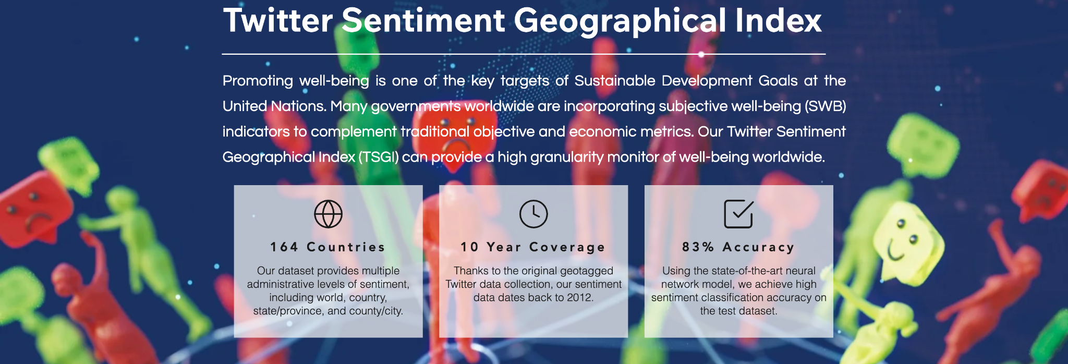


Objective
Approach
Solution
Provide a high-granularity monitor of subjective well being worldwide
Find expressed sentiment in tweets
Enrich every tweet in
CGA’s Geotweet Archive with sentiment
Notes:
With this idea in mind, we started this project of TSGI dataset. This project aims to develop a comprehensive Twitter sentiment geographical index (TSGI), which complements traditional surveys for timely SWB studies and provides a high-granuality monitor of subjective well being worldwide. We train sentiment classification model based on a labeled database and applies it to a global geotagged Twitter archive¹⁹ (containing 10 billion posts) from the Center of Geographic Analysis (CGA) of Harvard. While this scale of data was traditionally impossible to analyze, recent developments in natural language processing (NLP) have made it possible to automatically extract sentiment information from unstructured social media posts using high-performance computing infrastructures. We impute a sentiment score, defined as the probability of a post being classified as a post with the positive mood, for every post and aggregate them to multiple administrative levels (i.e., city/county, state, and country) on a daily basis.

Slide 4
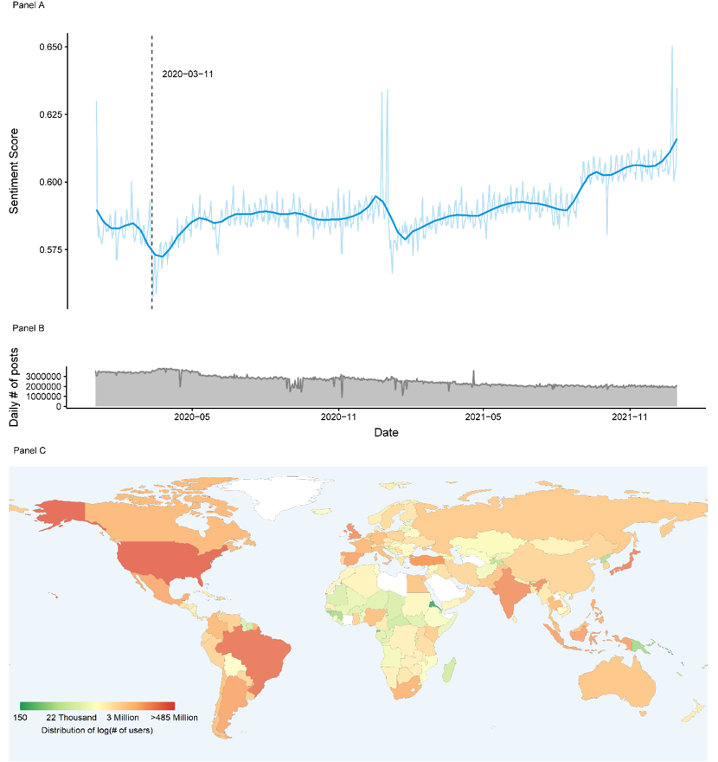







TSGI: Statistics
7.3 Billion enriched tweets
High Performance system running on NERC
Real Time enrichment (150,000 tweets/hours)
Global coverage (164 countries)
83% computation accuracy
10 years of data coverage (2012-Present)
Multiple administrative level daily indices
To the best of our knowledge, it is the first SWB dataset of this scale and granularity!
In contrast to the previous works focusing on SWB, TSGI is not limited to a specific topic, period, or location.
Notes:
This has resulted in a dataset of 7.3 billion enriched tweets. We have developed a high-performance system running on NERC. It is a real-time running at 150,000 tweets/hours.
What makes it unique is the high- frequency and to the best of our knowledge it is the first SWB data of this scale and granularity. In contrast to the previous works focusing on SWB, TSGI is not limited to a specific topic, period, or location.

Slide 5
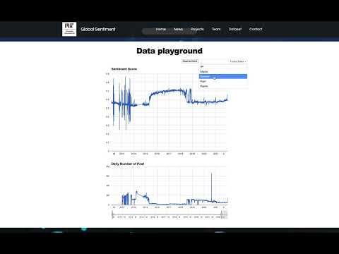
Dataset website
Notes:
Data website allows the user to a visualize of the historic and real-time sentiment and filter on geography and time.

Slide 6
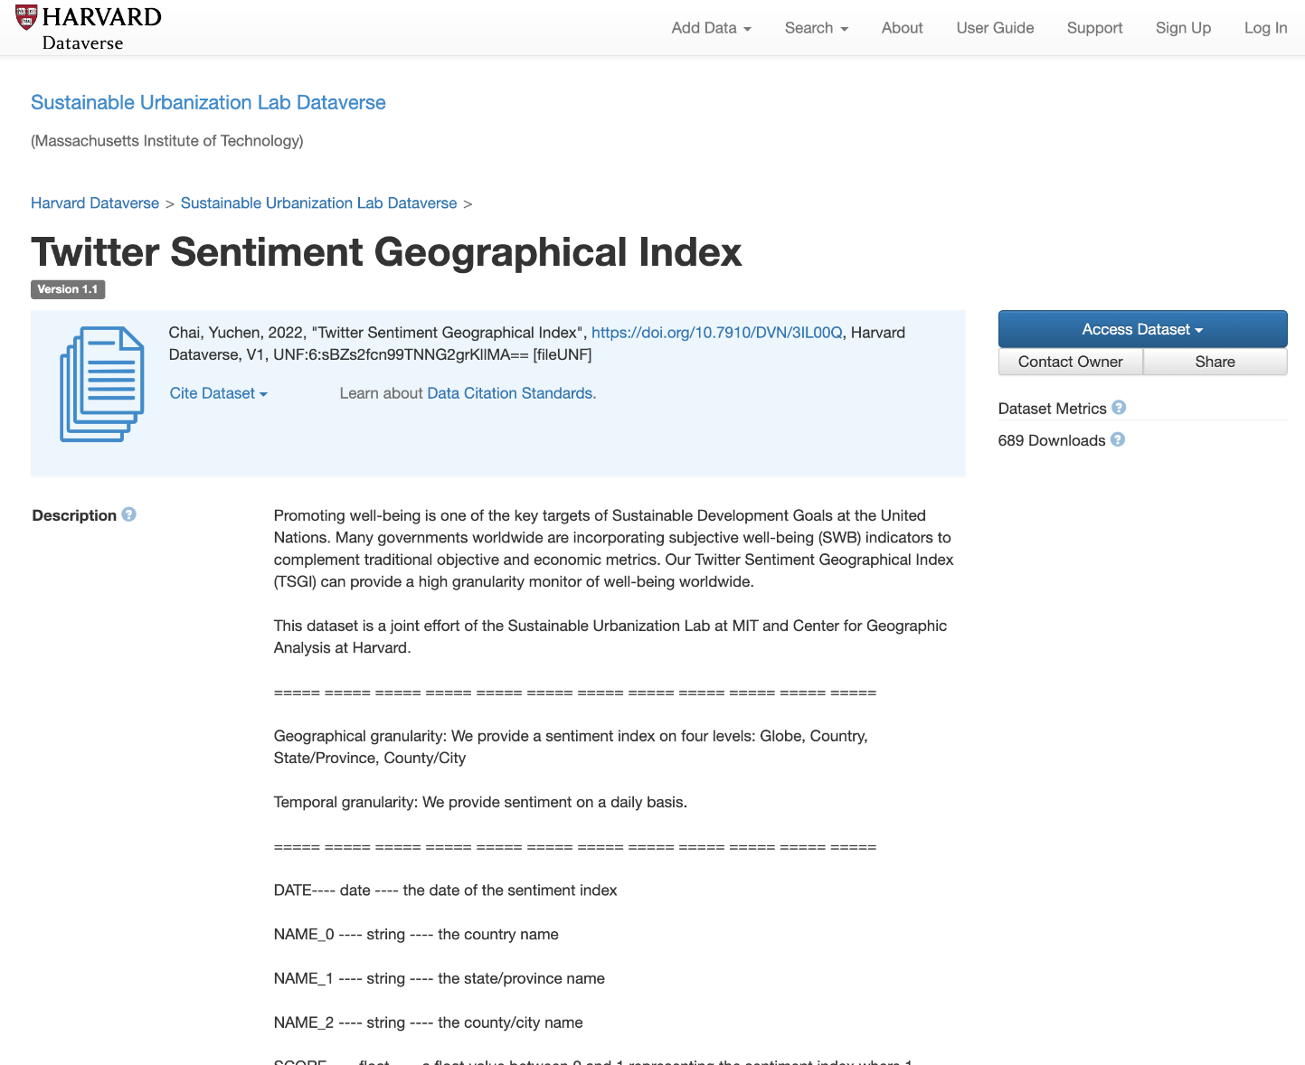
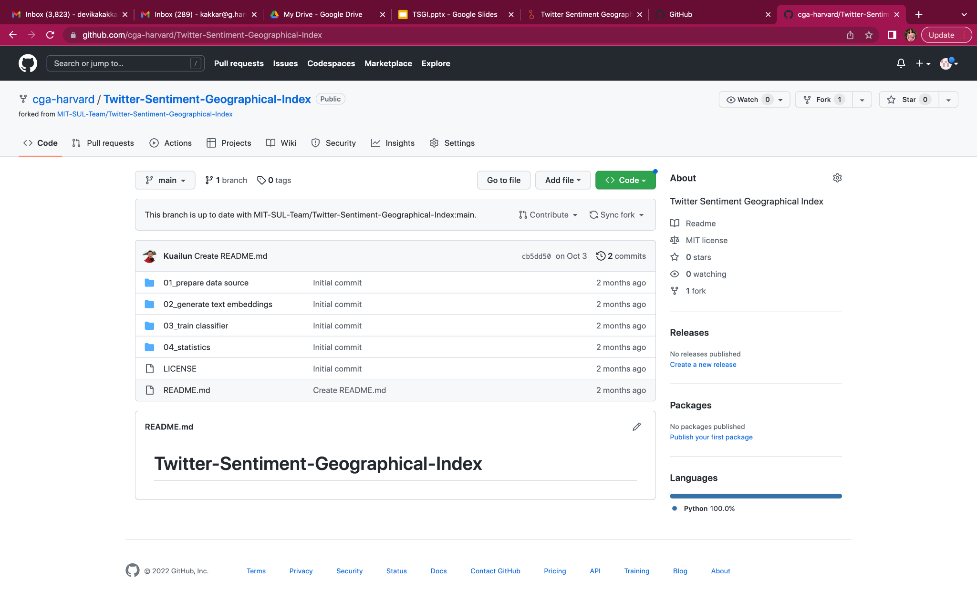
Data Availability: Open Access
Harvard Dataverse Archive
Github repository
Notes:
The aggregated multi-level (Globe, country, state, and county/city) daily sentiment indices are available on Harvard Dataverse. Users can access data for free and use any level of the index to best fit their purpose of usage.
The sentiment imputation codes, classifier and model are publicly available on Github.

Slide 7
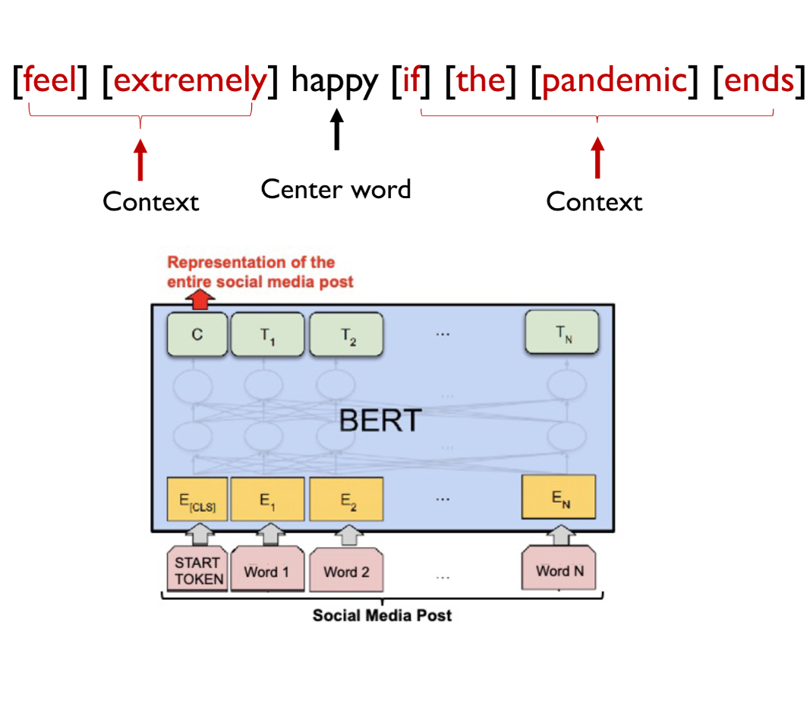
Methodology
1
LICW
Emoji
Hedonometer
BERT (developed by Google)
  Use neural network to classify posts which takes context into account
  Multilingual model can handle 104 languages
Dictionary based approaches
2
Machine Learning based Approach
Notes:
In computer science, the first is more dictionary base, like our IWC the animator emoji hat you assign the sentiment score to words containing emotion. And then, like each words will have a sentiment score the aggregate to the post level. So, which does not really take into account of the context, so if there are tweets that have the double negation with ambiguity in the expression, because of the context. This method are likely to have some misclassification in this kind of tweets. And there are 2nd category would be deep learning this algorithm like BERT developed by Google would be a typical example, so this algorithm they transform the post. including both a Center word and the context into some vector representation and then use some neural network to train a classifier into the sentiment score. For this method or more advanced algo can achieve multilingual sentiment analysis for BERT is achievable for more than 100 languages.

Slide 8
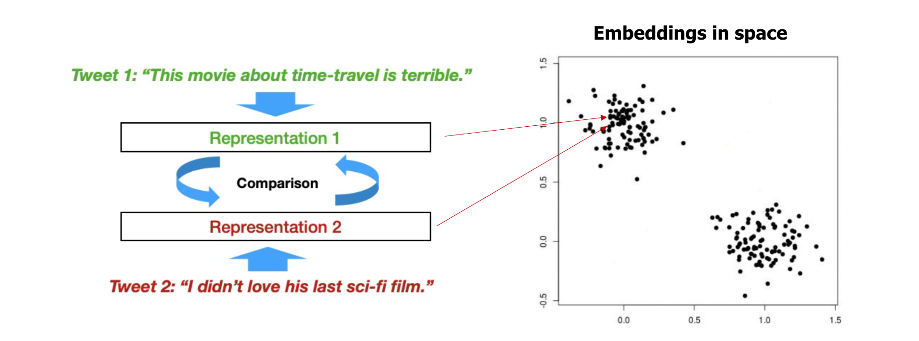
Methodology
BERT representations account for semantic meaning
Notes:
And because it's multi lingual nature and we wanted to a global study so multilingual nature is very important, and also its capacity account for context.BERT is the method we're going to use in our sentiment studies. And the BERT, like, for example, if two post one is like and, like oh this movie is terrible the other like I didn't. both of them will be classified into the negative clouds in the embedded states and others other kind of.

Slide 9
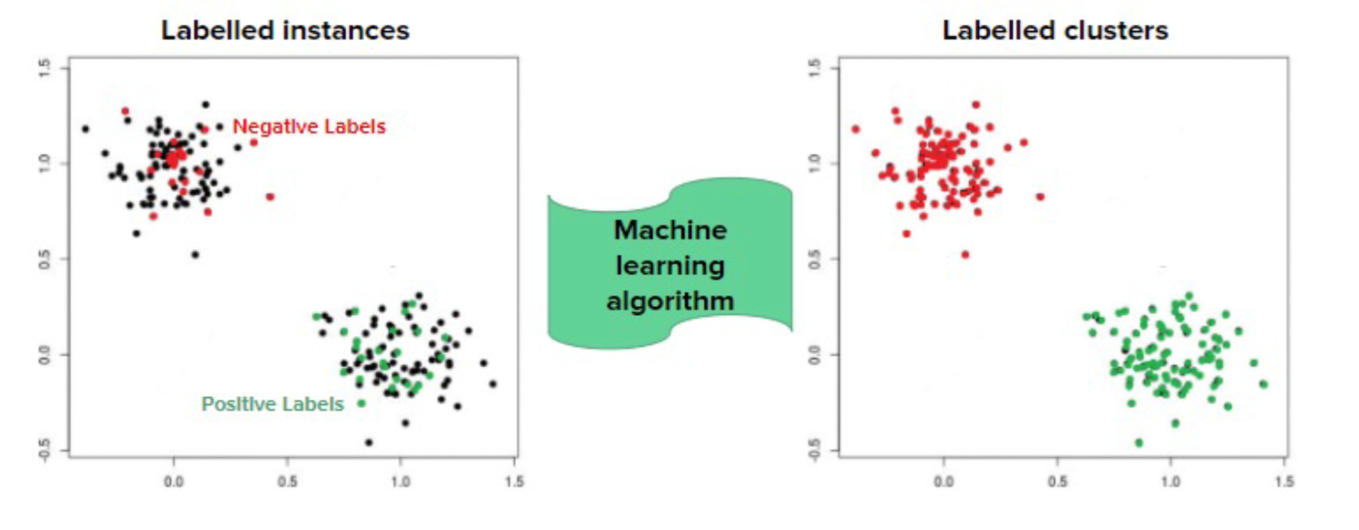
Methodology
We use supervised classification approach to train a 4-layer neural network model on labelled data (Sentiment140) using their BERT embeddings as inputs
Output: sentiment score 0 (very negative) - 100 (very positive)
Notes:
This is a very short overview about the bert methodology and we use a supervised classification approach which we train the machine learning model on some tweets was already labeled as the sentiment . We use to developed model to label or the other tweets so each post will be assigned a sentiment score between zero and 100 to indicate happiness now was very negative to a very positive.

Slide 10


Use Case: Global Sentiment and Climate Change
Impact of climate change on psychological well-being
What is the impact of climate events, such as temperature increases and environmental disasters on subjective well-being and happiness?
How has belief in Climate Change evolved over time?
Notes:
This is a collaborative project between MIT and CGA on Global Sentiment and Climate Change. This project aims to answers relevant climate related questions such as: hat is the impact of climate events, such as temperature increases and environmental disasters on subjective well-being and happiness?
How has belief in Climate Change evolved over time?

Slide 11
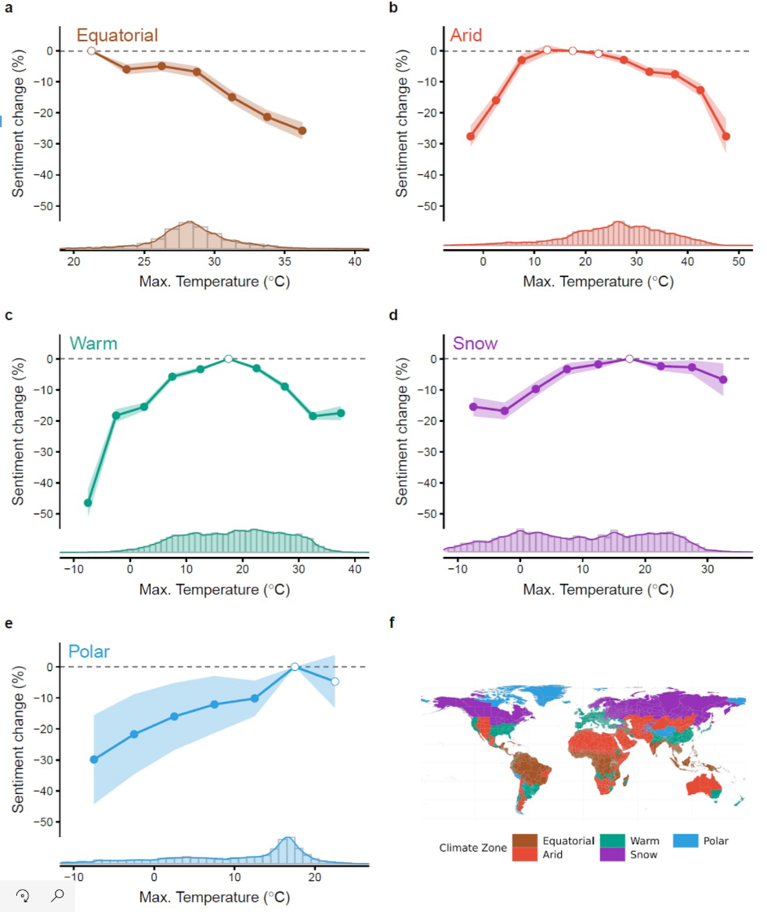
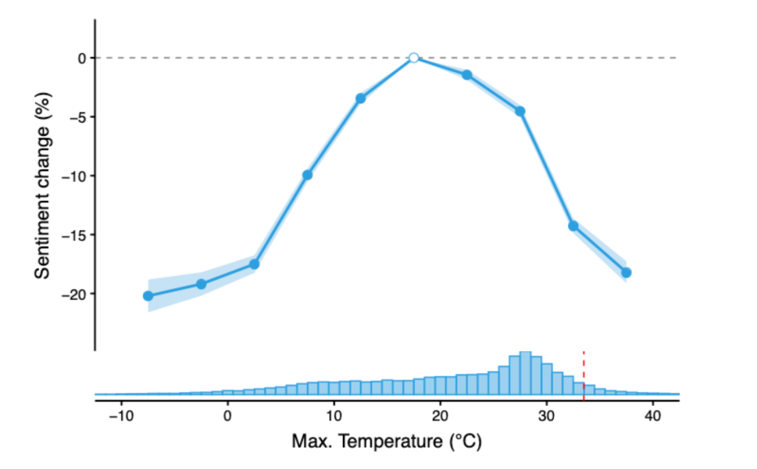
Global Sentiment and Climate Change
Ongoing collaboration with MIT SUL
Study the global nonlinear effect of temperature on human sentiment
Stay tuned for detailed results to be discussed in our upcoming publication!
Notes:
We already got some exciting preliminary results characterizing how people from different time zones are affected different psychologically when faced with extreme temperatures. For example, in equatorial regions we saw a rise in positive sentiment in snowy regions with rising temperature whereas in equatorial regions there was a drop in positive sentiment with rising temperature.

Slide 12



Results and Impact
Chai, Y., Kakkar, D., Palacios, J., & Zheng, S. (2022). Twitter Sentiment Geographical Index: A global high-frequency dataset for monitoring Subjective Well-Being. Nature Scientific Data (Under Review).
Dr. Juan Palacios
Head of Research, MIT SUL
Wang, J., Guetta-Jeanrenaud, N., Palacios, J., Fan, Y., Kakkar, D., Obradovich, N., & Zheng, S. (2022). A global nonlinear effect of temperature on human sentiment.
Nature Human Behavior (Under Review).
The MIT SUL Lab undertook a global study on the social costs of extreme weather events. The access to the archive of high-frequency geocoded tweets allowed us to include in our study granular measures of heat exposure and make use of state of the art econometric techniques to draw some causal links between extreme heat and expressed sentiment.
Notes:
Two publication : one on dataset and the second on use case are under review in Nature. This dataset has enabled researchers to include in their study for the first time very granular level of heat exposure to establish a causal link between extreme heat and sentiment. It has helped researchers find how extreme temperature affect mental health.

Slide 13
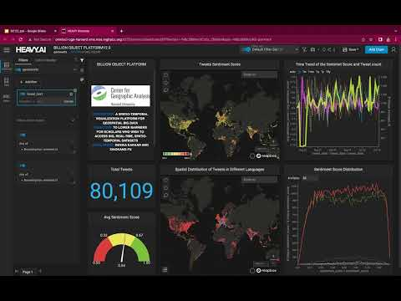
Future Work: Real-time system
Notes:
In future, we would like to users a real-time interactive platform to analyse and explore the sentiment score on latest tweets in real-time. Now I will play a prototype demo of this platform.

Slide 14
Questions/ Comments?
Contact us:
Harvard CGA
or
Email:
Devika Kakkar

